Slide 1
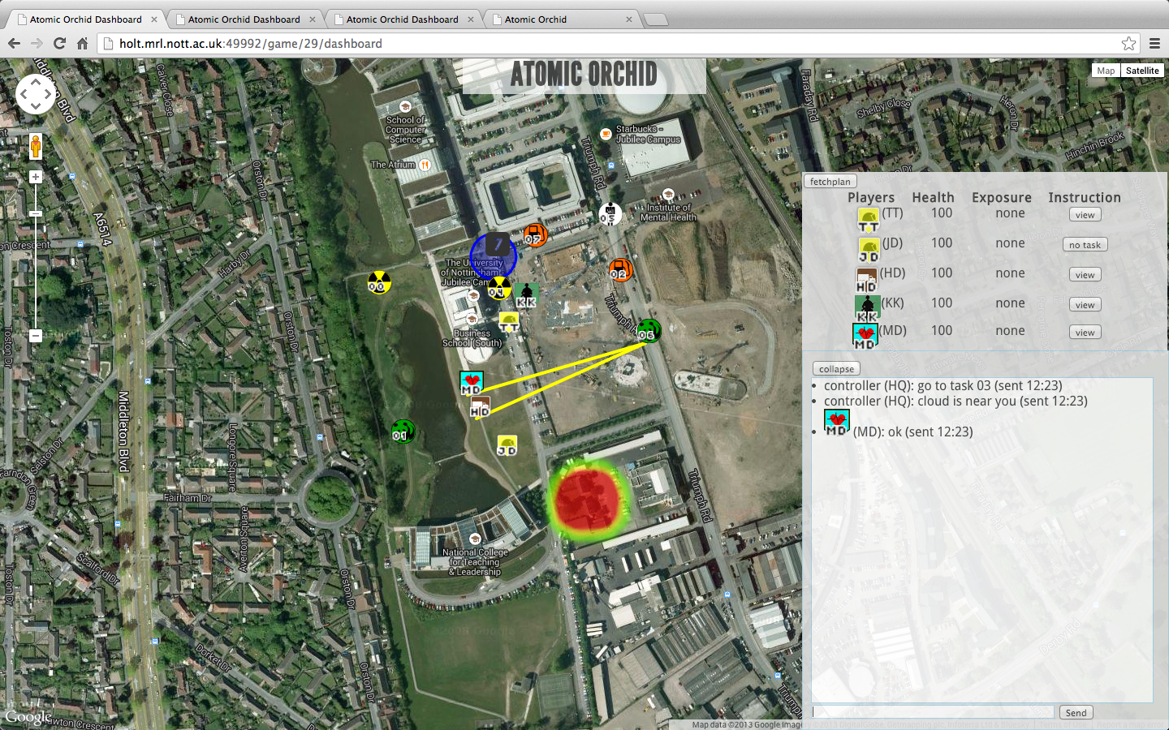
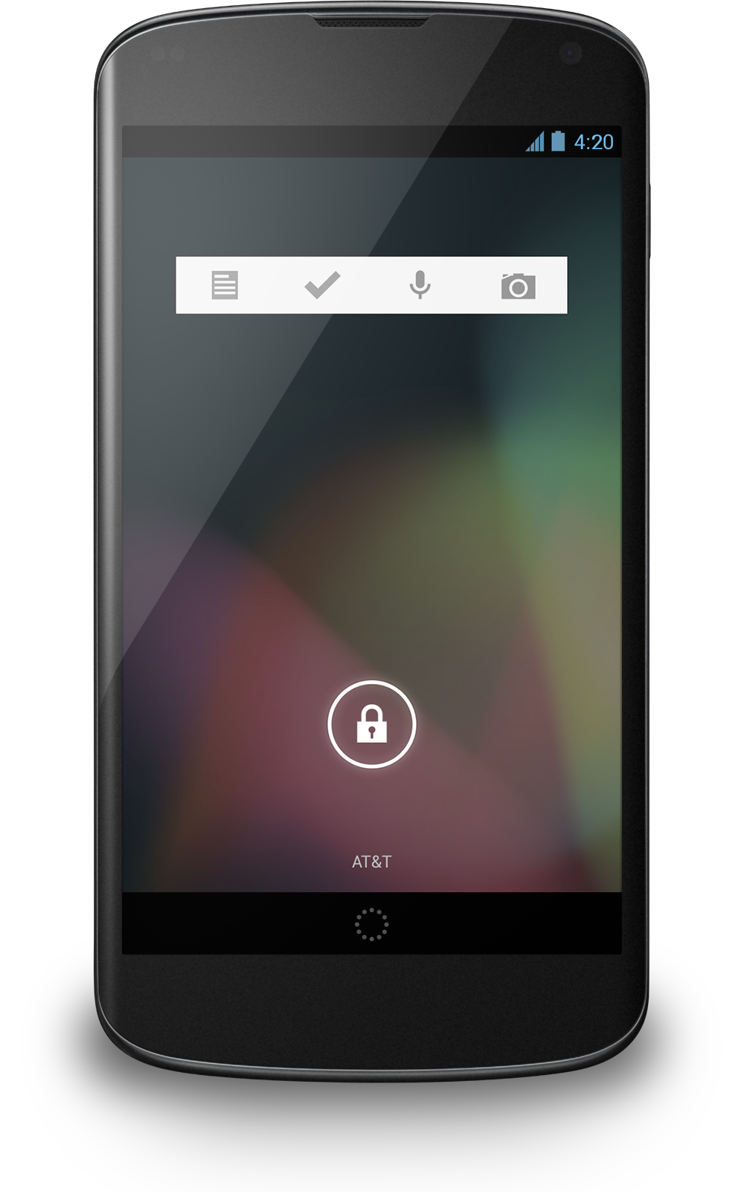
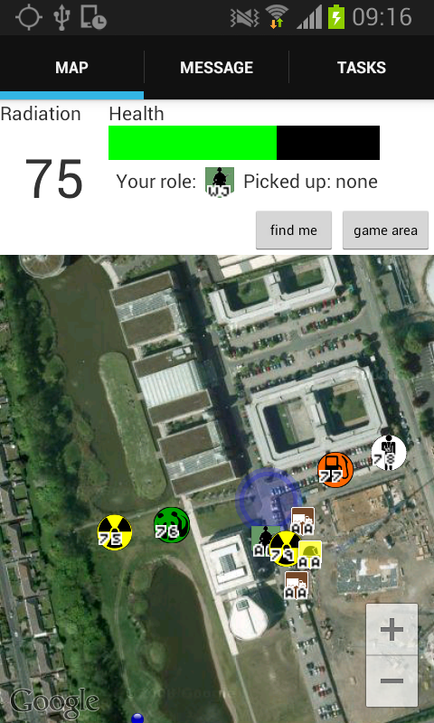
HQ Dashboard
Mobile Responder App
Drop off zone
Task allocation
Player status widget
Player and target icons
Radioactive cloud
Messaging widget

Slide 2
HQ Dashboard
Drop off zone
Task allocation
Player status widget
Player and target icons
Radioactive cloud
Messaging widget

Slide 3
Mobile Responder App

